Slide 1

AI-Powered Virtual Patient Support System
Enhancing Healthcare Efficiency & Patient Experience

Slide 2
Executive Summary
Current Challenge
Proposed Solution
Patients face significant delays in accessing care, whilst staff are overwhelmed with routine enquiries and administrative tasks that divert attention from critical patient needs.
Deploy an AI-powered virtual assistant integrated with existing EMR systems to provide immediate patient support and streamline operations.
Improved Efficiency
Reduced Wait Times
Enhanced Care Quality
Automate routine tasks and reduce administrative burden
Instant responses to common patient enquiries
Better patient engagement and medication adherence

Slide 3

Current Healthcare Challenges
Extended Wait Times
Patients experience lengthy delays for appointments, test results, and routine enquiries, leading to frustration and delayed care.
Overwhelming Call Volume
Administrative staff spend excessive time on repetitive questions, reducing availability for complex patient needs and critical tasks.
Medication Non-Adherence
Patients frequently miss medications due to lack of reminders and guidance, resulting in readmissions and compromised outcomes.
Limited After-Hours Support
Patients lack access to guidance outside business hours, leading to unnecessary emergency department visits and anxiety.

Slide 4
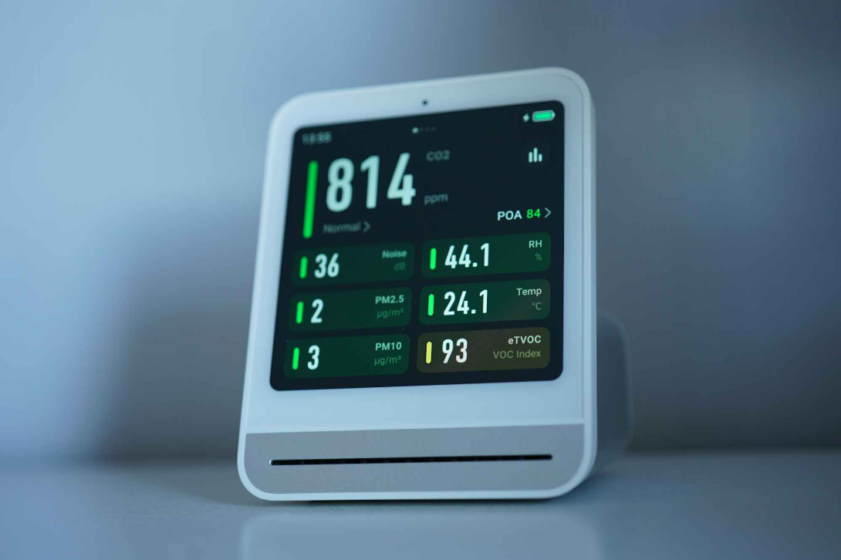




AI Virtual Assistant Solution
Comprehensive Patient Support
Our AI-powered virtual assistant integrates seamlessly with existing EMR systems to provide 24/7 patient support whilst maintaining complete data security and clinical oversight.
Intelligent Scheduling
Health Information Hub
24/7 appointment booking with real-time availability checks and automated confirmations
Instant answers to common health questions based on evidence-based medical guidelines
Medication Management
Seamless EMR Integration
Personalised reminders, dosage guidance, and adherence tracking integrated with patient records
Direct data flow between AI assistant and electronic medical records for consistent, accurate information

Slide 5





System Workflow
AI Assistant
Staff Escalation
Patient Query
EMR Update
The AI assistant serves as the first point of contact, handling routine enquiries whilst seamlessly escalating complex cases to appropriate clinical staff with full context and patient history.

Slide 6





Transformative Benefits
Instant Response Times
Enhanced Staff Productivity
Immediate answers to common enquiries, eliminating wait times for routine information and basic guidance.
Clinical staff can focus on complex cases whilst AI handles routine tasks, improving overall operational efficiency.
Improved Treatment Adherence
Superior Patient Experience
Proactive medication reminders and health guidance lead to better patient outcomes and reduced readmissions.
24/7 availability and consistent, accurate information delivery significantly enhance patient satisfaction scores.

Slide 7

Investment Overview
1
AI Platform Licensing
Monthly subscription for AI processing capabilities, natural language understanding, and continuous learning algorithms
2
EMR Integration Services
One-time setup costs for secure API connections, data mapping, and system compatibility testing
3
Cloud Infrastructure
Scalable hosting environment ensuring high availability, data security, and compliance with healthcare regulations
4
Training & Support
Comprehensive staff training programme and ongoing technical support to ensure successful implementation

Slide 8

Return on Investment
30-40%
20%
£150K
Reduced Wait Times
Staff Efficiency Gain
Annual Savings Potential
Significant improvement in patient access to information and services
Administrative staff freed up for higher-value patient care activities
Reduced overtime costs and improved operational efficiency
Long-Term Value
Reduced readmission rates through better medication adherence
Enhanced patient satisfaction scores and reputation
Competitive advantage in digital healthcare delivery

Slide 9




Risk Management Strategy
Data Privacy & Security
Risk: Patient data protection concerns
Mitigation: End-to-end encryption, GDPR compliance, regular security audits, and staff access controls
AI Accuracy & Liability
Risk: Potential for incorrect medical guidance
Mitigation: Clear escalation protocols, continuous AI training, and human oversight for all clinical decisions
Staff Adoption Resistance
Risk: Reluctance to embrace new technology
Mitigation: Comprehensive training programme, phased rollout, and hybrid approach maintaining human touchpoints
All risks are manageable through proper planning, training, and gradual implementation with continuous monitoring and adjustment.

Slide 10

Strategic Healthcare Transformation
The Future of Patient Care
This AI-powered virtual assistant represents more than operational improvement—it's a strategic investment in the future of healthcare delivery.
Enhanced Efficiency
Improved Accessibility
Streamlined operations with reduced administrative burden and optimised staff allocation
24/7 patient support ensuring consistent, high-quality care regardless of time or staffing levels
Strengthened Trust
Reliable, accurate information delivery that builds confidence in our healthcare services
By implementing this system, we position ourselves at the forefront of digital healthcare innovation, delivering measurable improvements in patient satisfaction whilst reducing operational costs and enhancing clinical outcomes.

